Slide 1
Parker / team intro

Slide 2
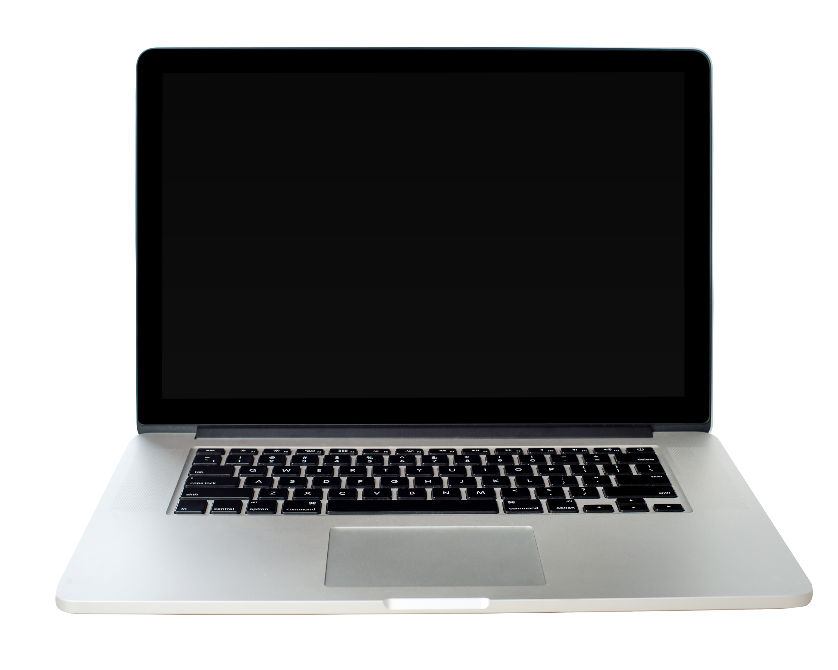
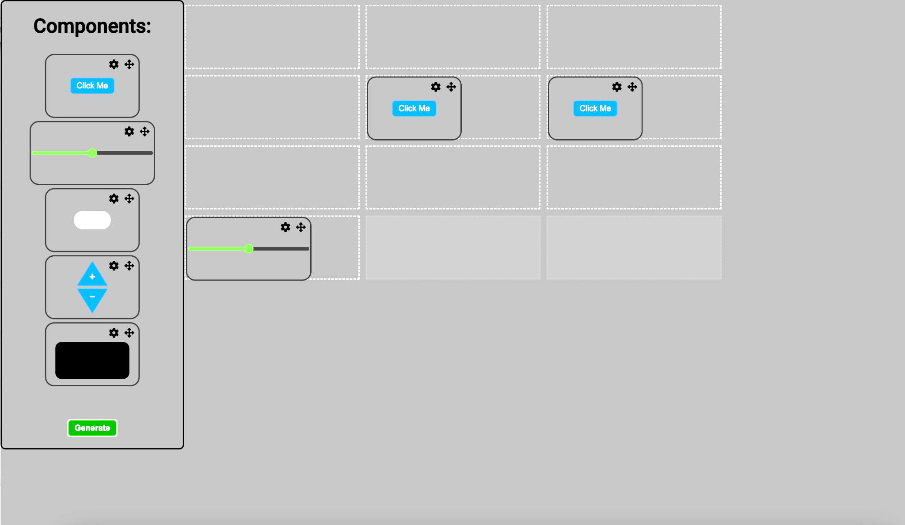
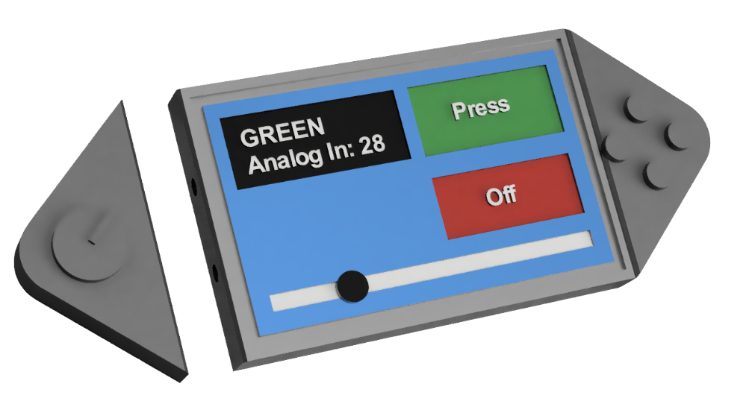
ProtoControl
A plug and play panel with a start-to-finish user interface development experience.
Proprietary Software Platform
Compatible with industry standard technology
Hot Swappable Custom Hardware
Configurable Touch Screen Display
Notes:
Protocontrol allows engineers and hobbyists to execute their vision for a user interface panel with a start-to-finish user interface development experience
Bring the audience to the same place as us before diving into details, set the tone, differentiate ourselves from other projects
Software platform to design user interface layout
Touch-screen display
Hot swappable hardware
Compatible with industry standard technology

Slide 3
Kelly mae
WiFi Setup
How device IDs work
Communication protocol

Slide 4
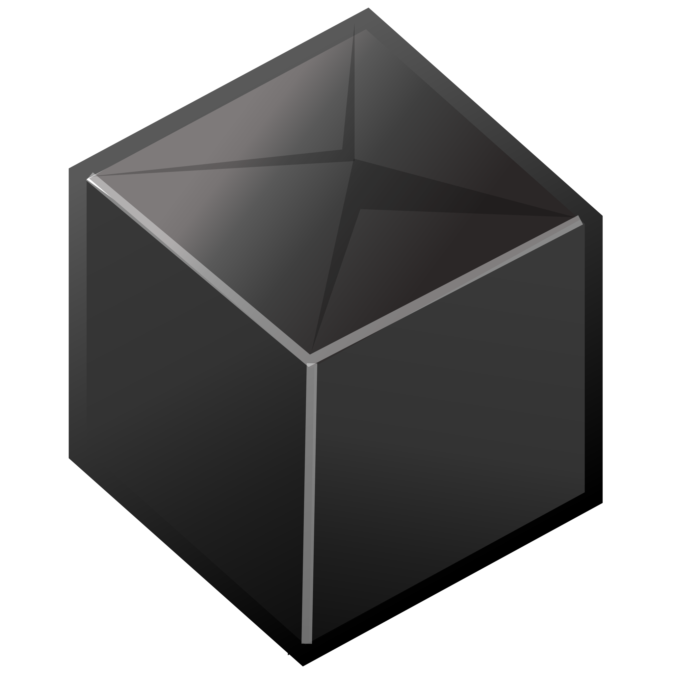
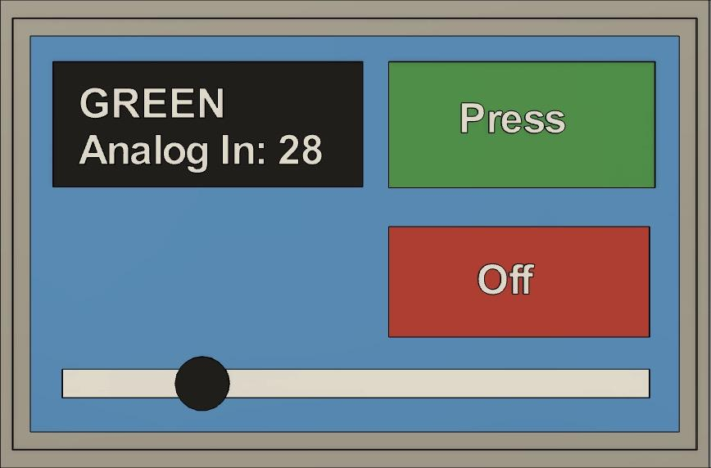
Communication & Integration
Website Profile
- User builds desired profiles on website & saves to database
- Protocontrol gets the profile via an HTTP request to our listed endpoint
-The endpoint returns the most recent profile created on the site
Control Profile
- Protocontrol firmware takes string generated by website - Dynamically casts the user’s profiles from given parameters using screen location and initial values.
Send and Receive Updates
- During operation, Protocontrol looks for inputs to the local components and updates from the user device
- By monitoring the UART channel, Protocontrol updates values on screen and sends input updates
UART
WiFi

Slide 5
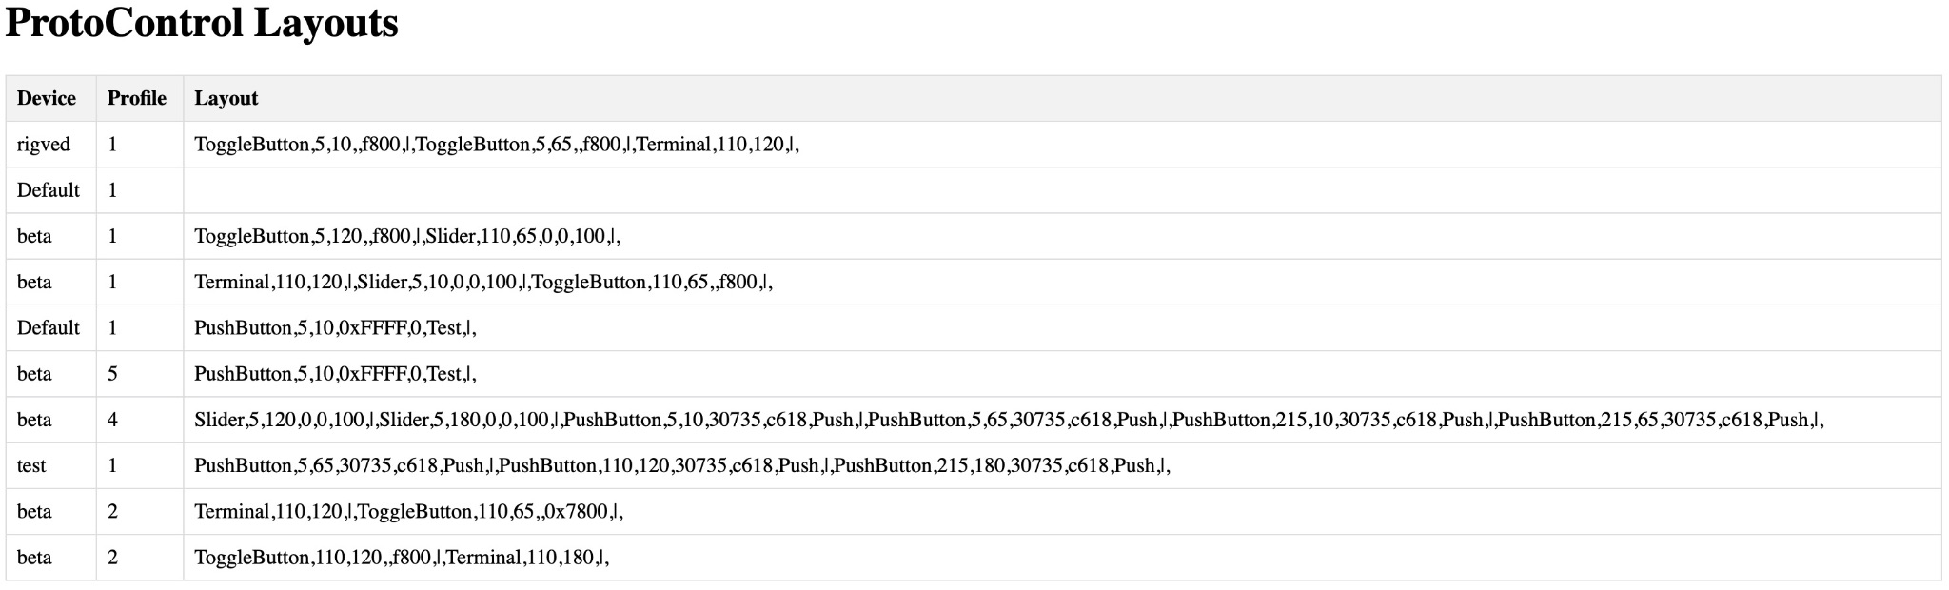
Profile’s and Communication
ESP 32 Flash Memory
P1
ToggleButton,110,120,,f800,|,Terminal,110,180,|,
P2
Terminal,110,120,|,ToggleButton,110,65,,0x7800,|,
P3
PushButton,5,10,0xFFFF,0,Test,|,
P4
ToggleButton,5,120,,f800,|,Slider,110,65,0,0,100,|,
P5
Terminal,110,120,|,Slider,5,10,0,0,100,|,ToggleButton,110,65,,f800,|,

Slide 6
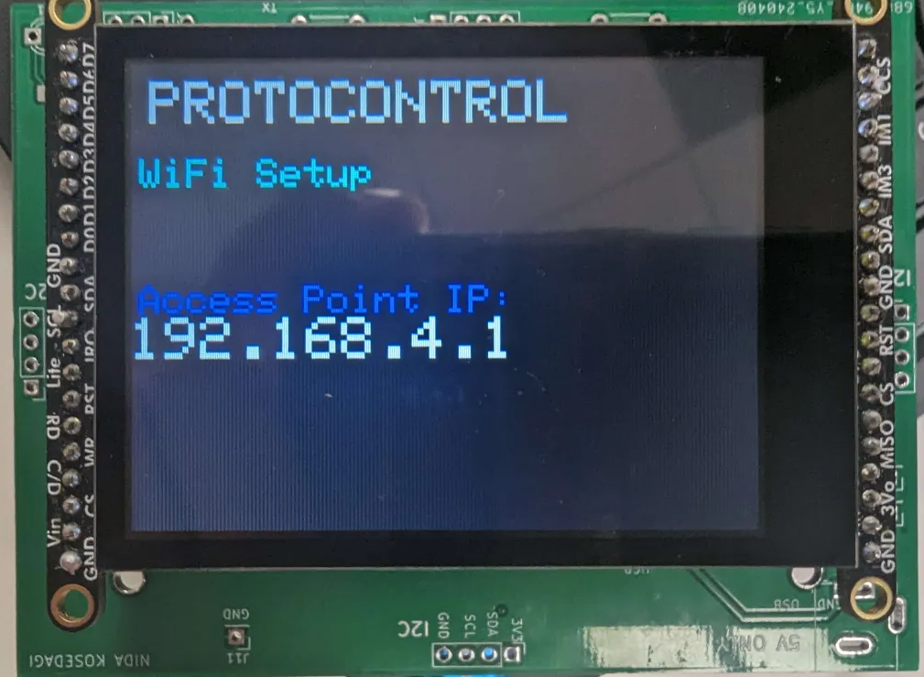
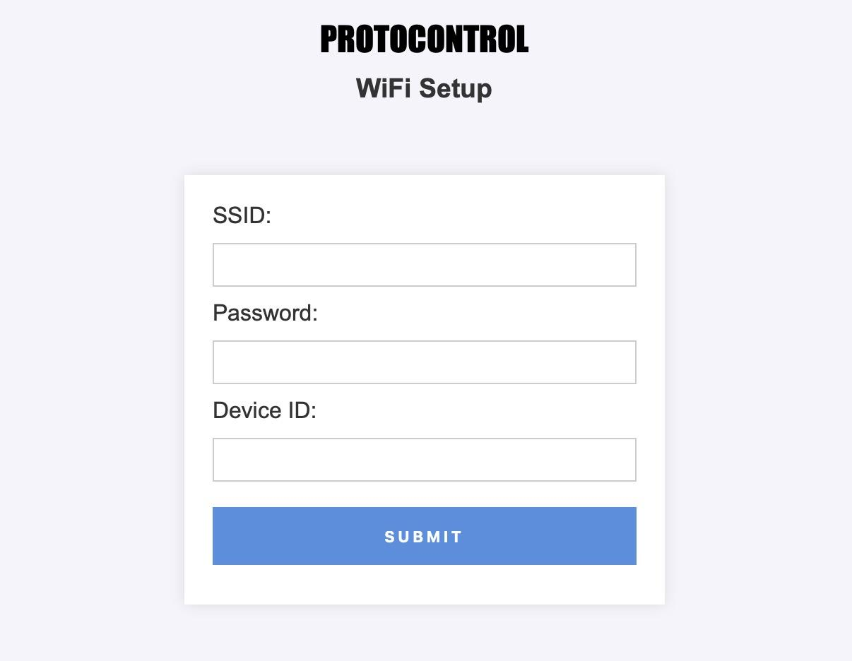
Protocontrol 1st Time Set Up
1. Go to device hosted server
2. Input WiFi parameters and Device ID

Slide 7
Will
Website Overview (Angular, NoSQL, Flask)
Visuals: QR code for website, tech stack visuals
How to use website
Flow chart
How we identify data (DB schema)
Deployment diagram
Build layout for msp430 demo
306 demo

Slide 8
Parker
String parsing
Challenge: Arbitrary digital components / oop
I created a comprehensive header defining classes for each of the digital compintents, so no matter how the profile is layed out, each component handles inputs correctly and outputs data correctly
Draw and touch functionality based on changing location
Looks for physical components
Scans for i2c adress
Sends serial data to user system
Sends message as human readable characters
Outputs setup information on start, and echos Serial output to monitor

Slide 9
Abisha
Important to also have tactile components so the users have as many options as possible as they go through the iterative process
Challenge: how can the user know where the data came from? Two solutions, one for digital components and one for physical components
Why I2C? In order to have hot-swappable components, we need a way to distinguish between multiple components. We decided to utilize I2Cs addressability. Each hardware peripheral has a unique address
Look for addresses within a certain range (on startup and every time we query the website)
Digital uses PCF8574 (gpio pin expander) and a custom PCB (up to 8 unique addresses)
Rotary encoder
Keypad
buttons
Analog uses ADS1115 on a breakout board (up to 4 unique addresses)
Joystick
slider
Challenge: finding libraries that integrate with pcf8574 chip

Slide 10
Nida
Focuses on two products: main board and the component pcb
Main board: acts as a shield between the microcontroller and the touchscreen, provides multiple options to be powered such as barrel jack and Vin ports (in addition to the microcontroller), UART port, two switches to switch between user profiles and most importantly the I2C ports and we had many iterations of this board before we finalized the design as you can see here on the table
Component pcb: provides GPIO pins for I2C components and another port for these components to interact with the main board, 3 resistors to be able to assign unique address values to each component
Challenges: being new to pcb design and learning how to use KiCad, learning how to integrate vias to get rid of inner layers, learning how to flood planes on the board to minimize the number of traces
The total current draw of protocontrol even with components connected is about 200 mA which means the total power usage is approximately 1W

Slide 11
Alarm System Demo
Now that you have an idea of both the software and hardware aspect of our device, we would like to present an example application of protocontrol: a security system for your room. Let’s say you want a heads up before someone walks into your bedroom, protocontrol can help you control a system consisting of an ultrasonic sensor and a buzzer that goes off when it detects motion outside. Abisha will walk you through how you can utilize this system with the protocontrol.
[While demonstrating the system] The system is initially disarmed. In order to arm the system, you press the toggler. At this point the sensors are On. When you get close to the sensor the rgb led turns red and the buzzer starts sounding. If you move outside of the radius, the led and buzzer turns off. However the system is still armed. In order to disarm the system you must enter a pin. If the pin is invalid, the system remains armed. If the pin is valid, the sensors turn off and motion isn’t detected.
Introduce the claw machine: going from a hobbyist type project to a more complicated system.

Slide 12
Claw Machine
Inputs are joystick and toggle
String is sent to pi and parsed into gcode command or servo state

Slide 13
Summary

